Slide 1
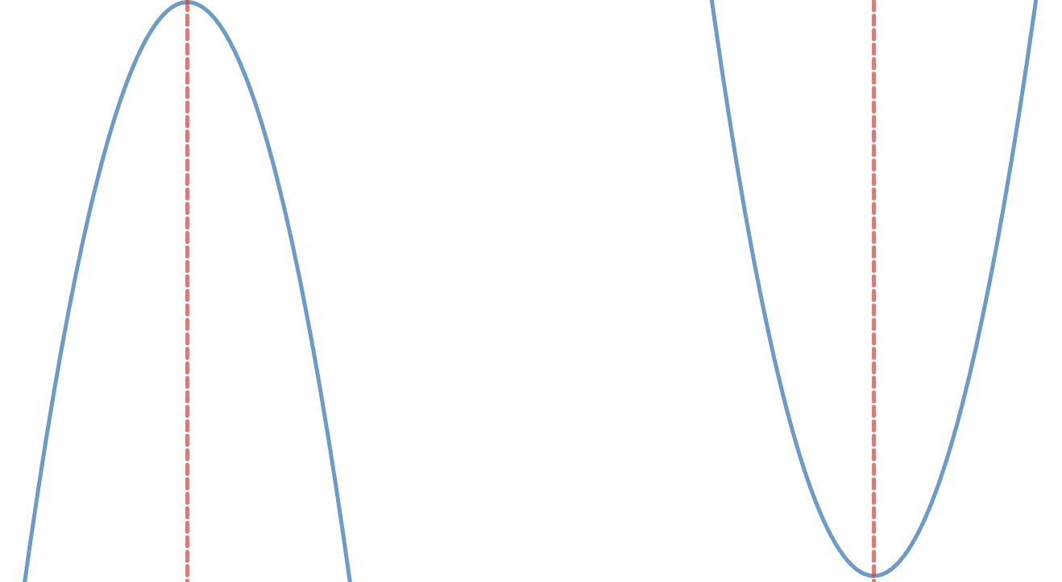
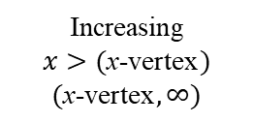
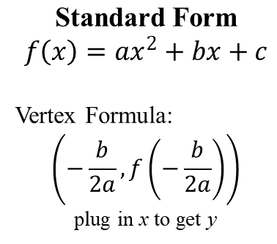
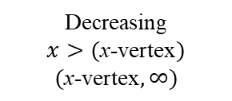
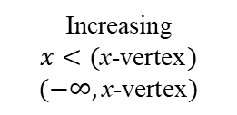
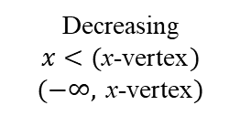
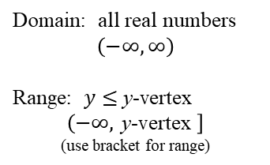
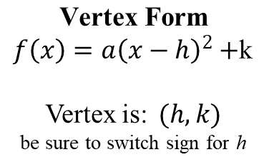
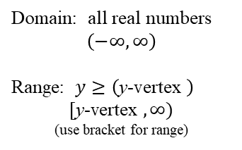
$$\text{Standard} \text{Form}$$
$$f\left(x\right)=ax^{2}+bx+c$$
Vertex Formula:
$$\left(−\frac{b}{2a}, f\left(−\frac{b}{2a}\right)\right)$$
plug in x to get y
NOTE: Both Standard Form and Vertex Form can open either UP or DOWN.
$$\text{Vertex} \text{Form}$$
$f\left(x\right)=a{\left(x−h\right)}^{2}+$k
Vertex is:$(h,k)$
be sure to switch sign for h
Leading Coefficient (a)
a < 0
(negative)
a > 0
(positive)
Maximum value is (y-vertex)
opens
DOWN
opens
UP
Decreasing
$$x<(\text{x}\text{-}\text{vertex})$$
$$(−∞, \text{x}\text{-}\text{vertex})$$
Increasing
$$x>(\text{x}\text{-}\text{vertex})$$
$$(\text{x}\text{-}\text{vertex},∞)$$
Domain: all real numbers
$$\left(−∞,∞\right)$$
Range: $y≤$ y-vertex
$$\left(−∞, \text{y}\text{-}\text{vertex} \right]$$
(use bracket for range)
Domain: all real numbers
$$\left(−∞,∞\right)$$
Range: $y≥\left(\text{y}\text{-}\text{vertex} \right)$
$$[\text{y}\text{-}\text{vertex} , ∞)$$
(use bracket for range)
Increasing
$$x<(\text{x}\text{-}\text{vertex})$$
$$(−∞, \text{x}\text{-}\text{vertex})$$
Decreasing
$$x>(\text{x}\text{-}\text{vertex})$$
$$(\text{x}\text{-}\text{vertex},∞)$$
Minimum value is (y-vertex)
Axis of Symmetry
Equation is: x = (x-vertex)
Section 3.1
Quadratic Functions

